Slide 1
بِسْمِ ٱللَّهِ ٱلرَّحْمَٰنِ ٱلرَّحِيمِ

Slide 2
Course: Web Designing
Institute: Corvit Systems Peshawar
Duration: 3-Month Web Designing & Development Course
2nd class of JS (Java script)
Topic : JavaScript function and events

Slide 3
Instructor: Muhammad Sahil
BS in Computer Science – University of Peshawar
1 Year MERN Stack Developer – E Digital Pakistan (KPITB)
1 Year Web Instructor – E Digital Pakistan
6 Months Web Instructor – University of Peshawar
Computer Science Teacher – Alflah Model College, Sarband
Experience with multiple local client projects
Full Stack / MERN Stack Web Developer | Web Instructor

Slide 4
What is a Function?
A function is a block of code that can :
Performs a specific task
Runs only when it is called
Helps reduce code repetition
Functions make code clean, reusable, and organized.
Any keyword end with ( ) is a function in js.

Slide 5
Function Declaration
Defining anything in js is called declaration i.e variable declaration ,function declaration
A simple function without parameters.
Example concept:
Function is defined
Function is called
Code inside function runs
Used for greeting messages, actions, calculations.

Slide 6
Functions with Parameters & Return
Functions can:
Receive values using parameters
Send back result using return
Benefits:
Reusable logic
Dynamic output
Cleaner code
Used in calculators, forms, and logic handling.

Slide 7
What are DOM Events?
DOM Events are actions performed by users on a webpage.
Common events:
click
mouseover
input
Events allow JavaScript to respond to user actions.

Slide 8
Selecting HTML Elements
JavaScript selects HTML elements using their IDs.
Selected elements can be:
<Buttons>
<Text>
<Headings>
<Input> fields
After selection, JavaScript can change content and style.

Slide 9
Event Listeners
Event Listener listens for an event and runs code.
Example actions:
Button click → change text
Mouse over → change color
Typing → show live input
Makes websites interactive and dynamic.

Slide 10
input Event (Live Typing)
input event runs when user types in input field.
Uses:
Live text preview
Form validation
Search suggestions
Improves user experience.

Slide 11
Real-Life Examples
Functions & Events are used in:
Buttons and forms
Login systems
Calculators
Interactive websites
Almost every modern website uses them.

Slide 12
Code example Screen shots from next slide

Slide 13
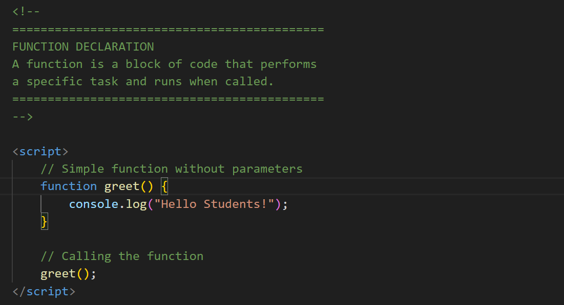
function Declaration

Slide 14
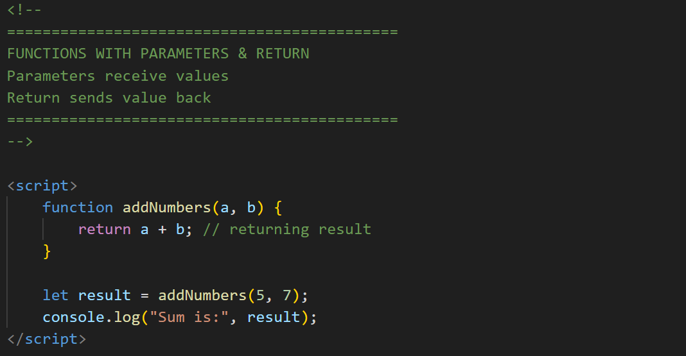
Parameters & return

Slide 15
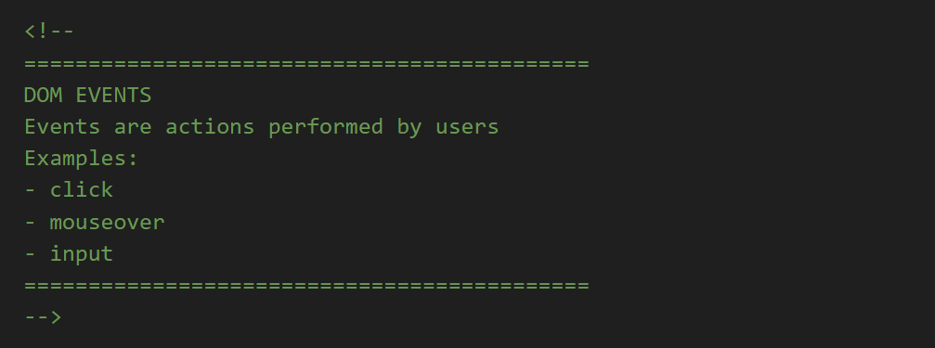
DOM Events ?

Slide 16
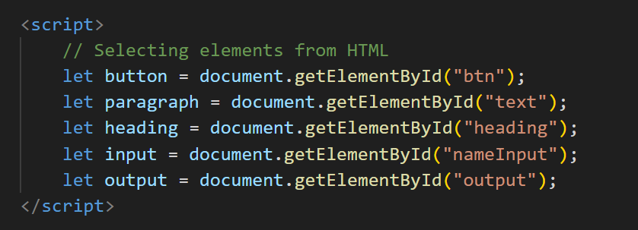
Selection by getElementById();

Slide 17
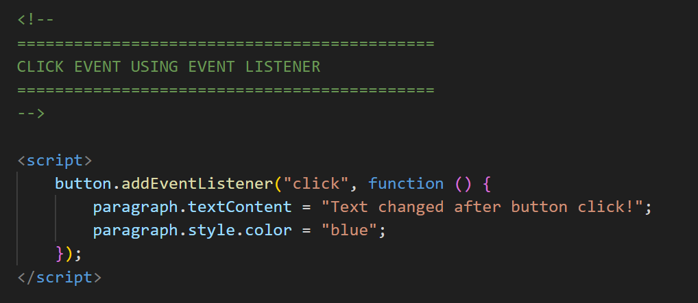
click Event listners

Slide 18
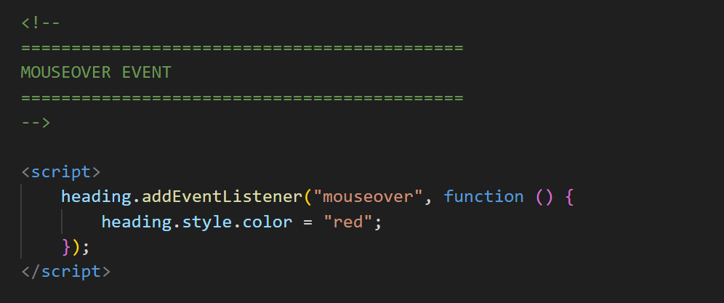
mouseover( );

Slide 19
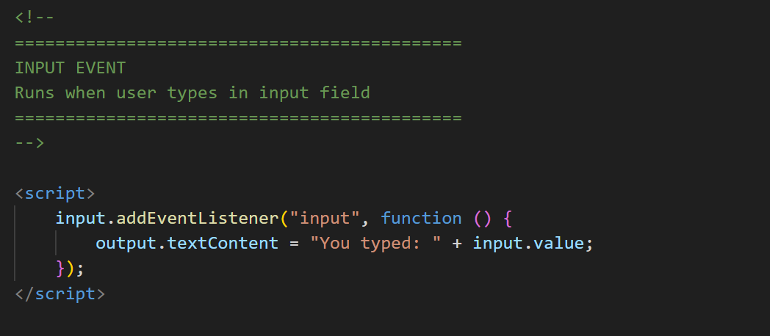
input Events

Slide 20
Summary
Today you learned: • Functions & parameters • Return values • DOM events • Event listeners

